Slide 1
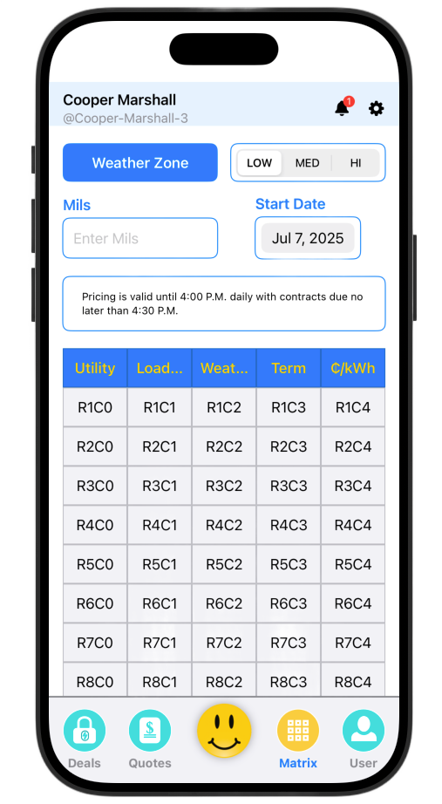
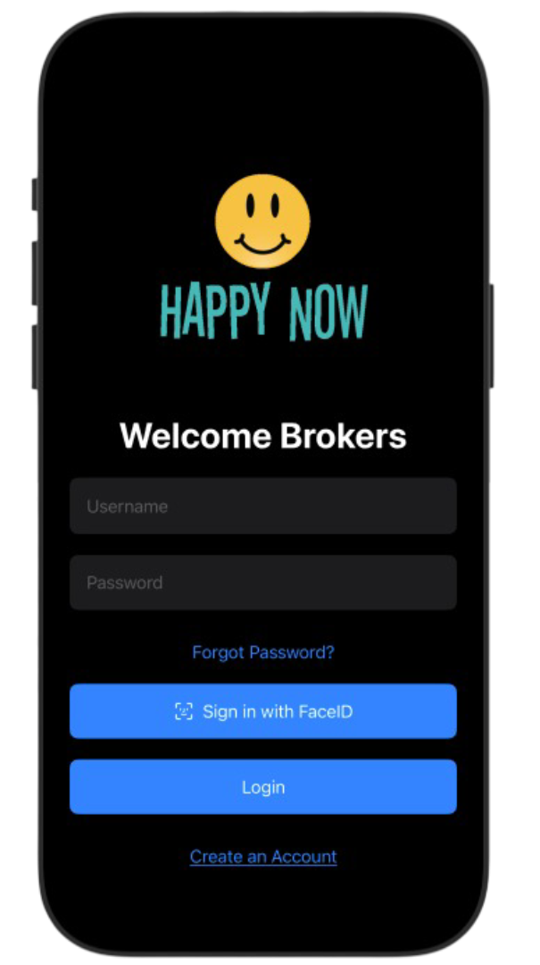
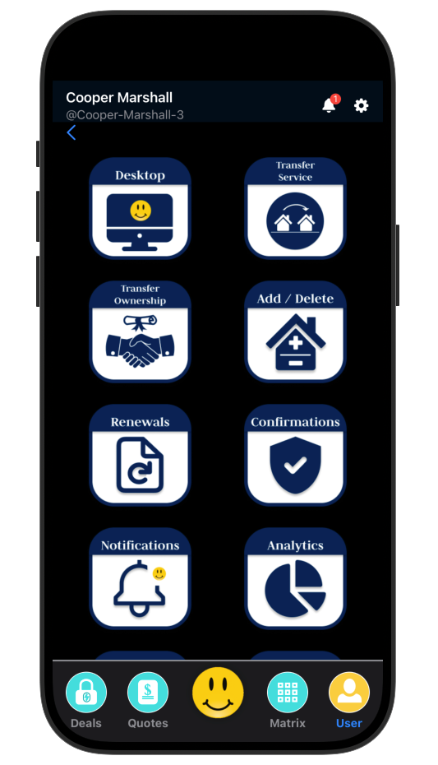

Happy Now Solutions LLC: Broker Portal & App powered by H.U.M.

Slide 2
Problems
Solutions
Pricing electricity and generating deal flow is incredibly time-consuming (hours to days) due to limitations in REP capabilities and manual historical-usage processes.
Pulling historical-usage data remains a fully manual task.
Brokers are disorganized and inefficient with the current toolset.
The energy sector is highly conventional and relies on antiquated technology.
After Winter Storm Uri, price volatility surged from week-long stability to daily fluctuations.
Retail Electric Providers depend on a hodgepodge of third-party services, inflating costs and headcount.
Develop an automated Historical Usage Engine.
Integrate the HUM into a state-of-the-art broker marketplace app and web portal by Happy Now Solutions LLC.
Execute both initiatives with a lean, in-house team of subject-matter experts.

Slide 3


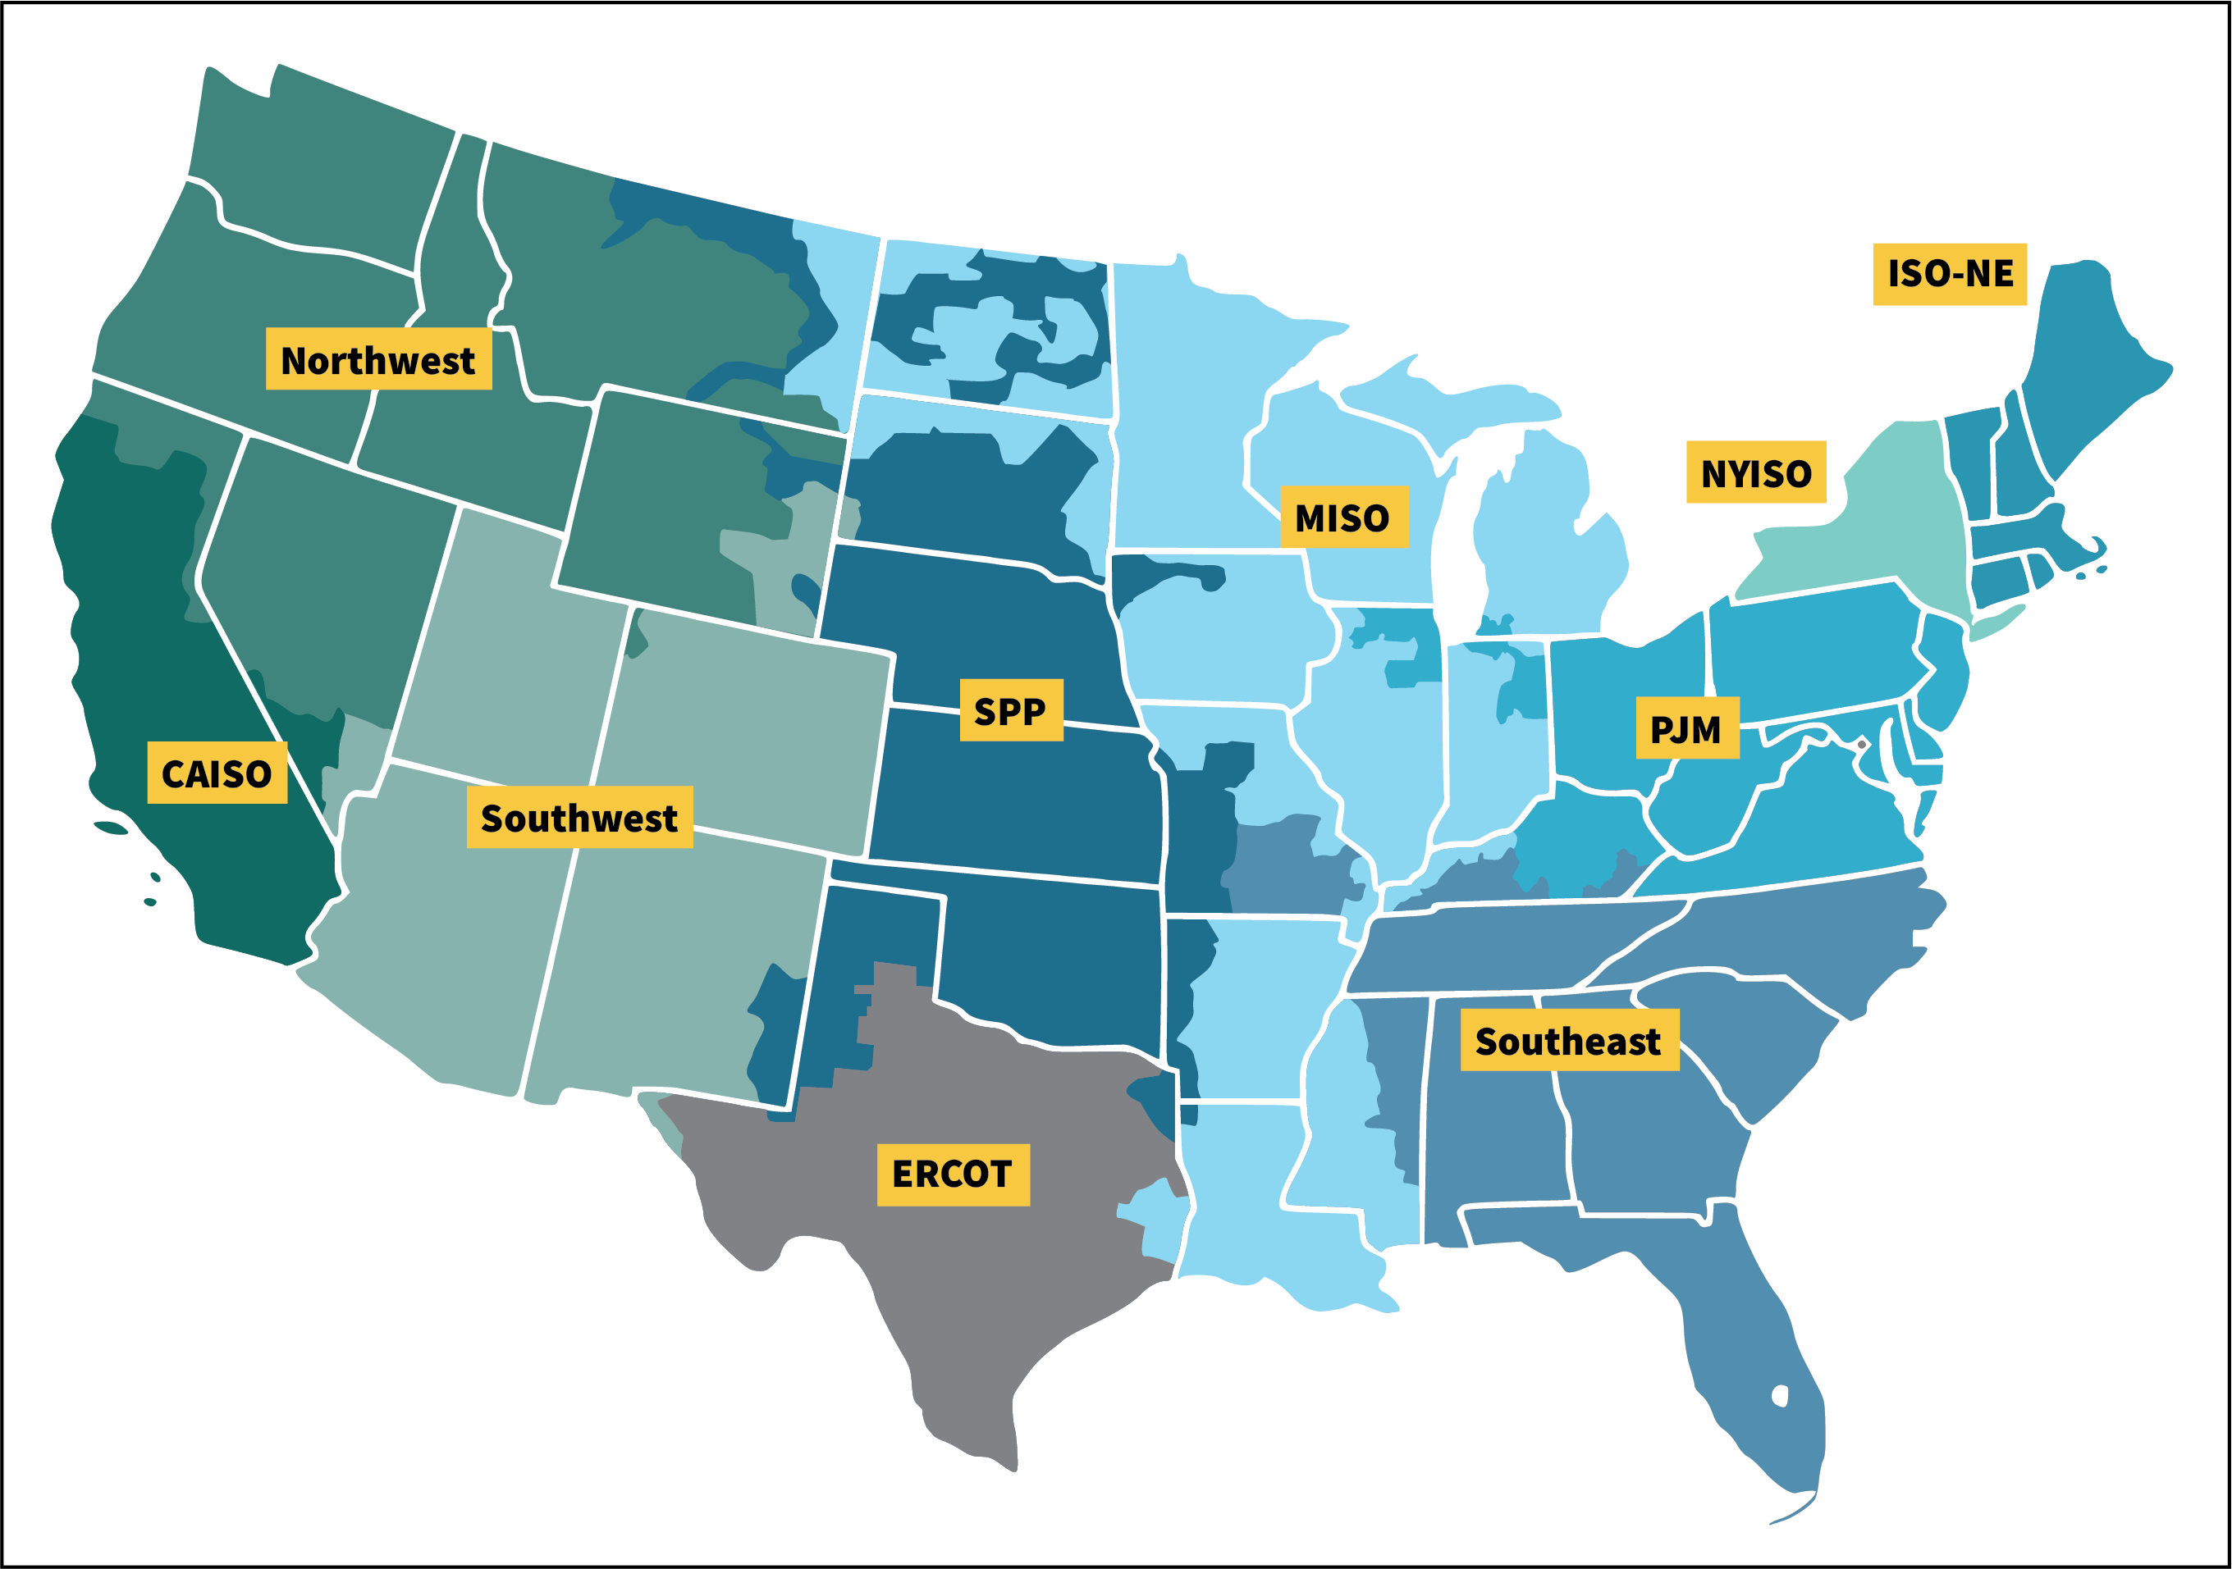
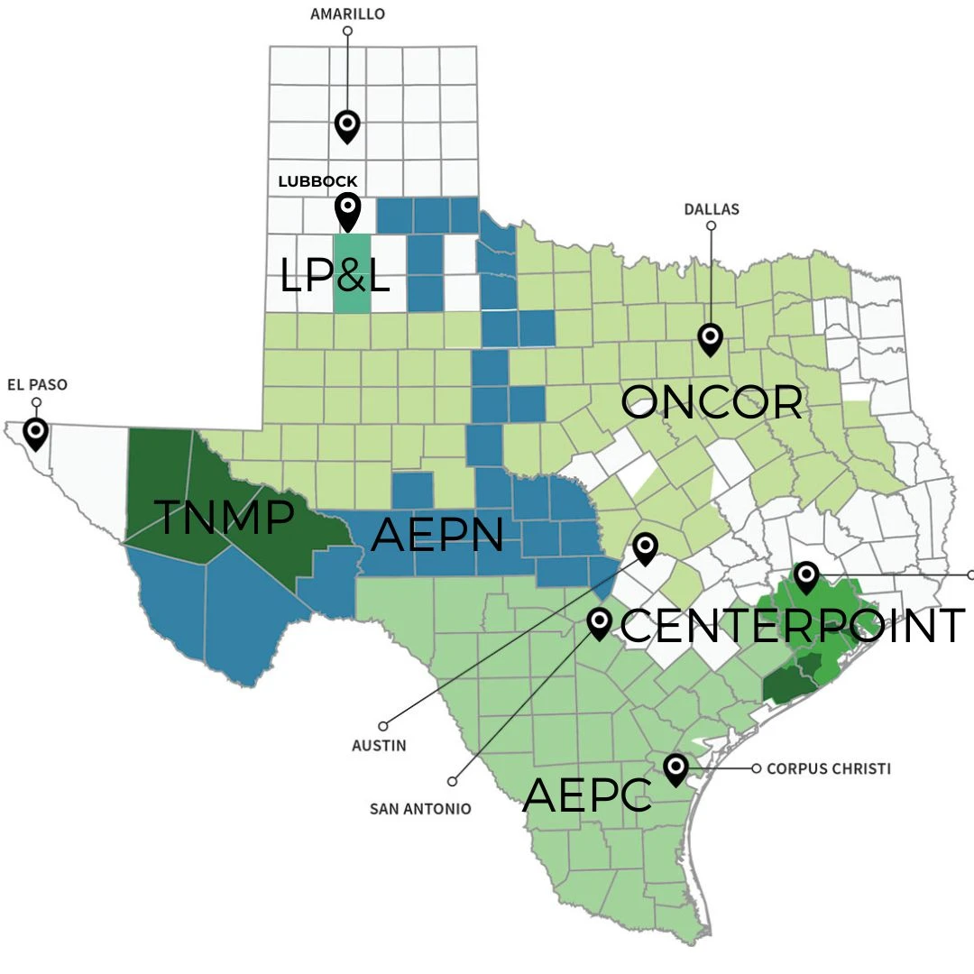
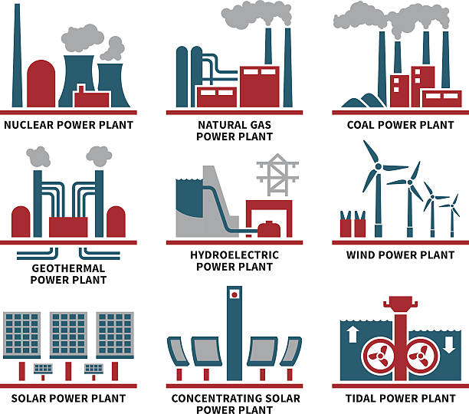







Governed by the PUCT
Governed by the PUCT
Grid Level
Transmission and Distribution Service Provider (TDSP) Level
“Market” Level
Generation- “Wholesale”
“Retail” Electric Providers
Customer Level

Slide 4
What is Historical Usage?
Past 12 months of consumption (measured in kWh) used to forecast and price accounts.
Customer Profiling
Consumption data segments customers into usage tiers (residential vs. commercial).
Rate Differentiation
Heavy consumers receive discounted rates based on their profile.
No HU? No Customization
Accounts without historical data default to the Base Market Rate—limiting broker commissions.

Slide 5
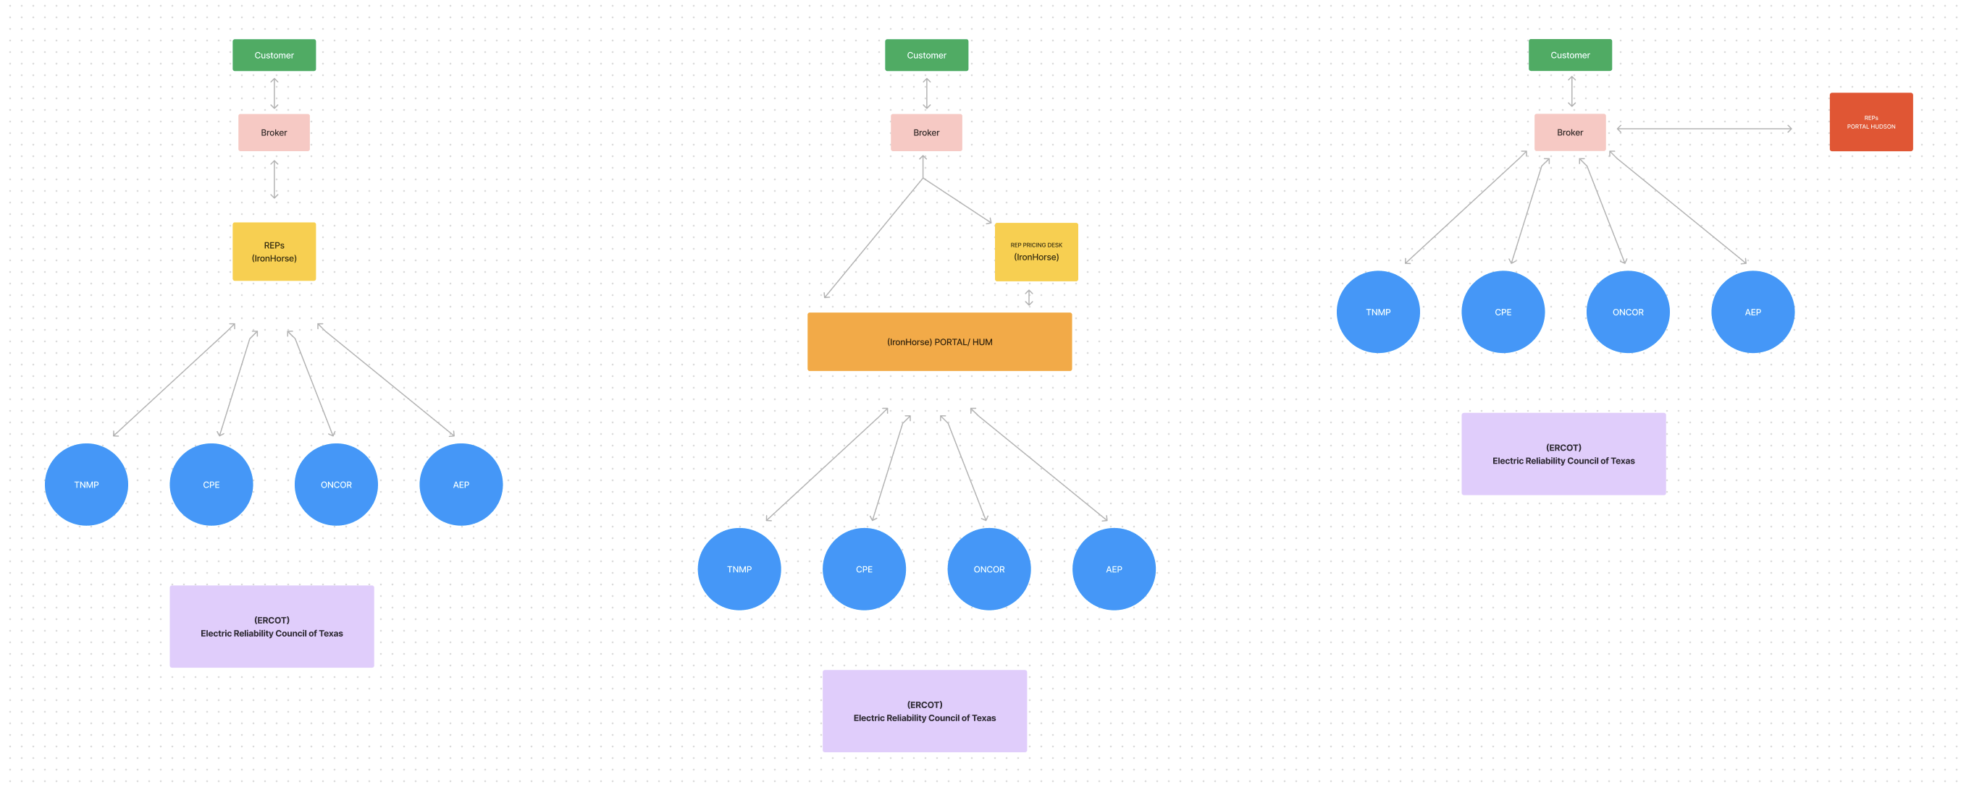
HUM FLOW Comparison

Slide 6
Overview
Garner Investment To:
Assemble a Specialized Core Team
  Recruit an ERCOT risk-management trio (15 yrs combined experience; lead with 5+ yrs)
  Onboard five full-stack app & web developers (ERCOT EDI expertise)
Build the HUM Platform & Broker App / Portal
  Architect the historical usage machine (HUM)
  Design/develop the broker execution & analytics app
Establish a Licensed REP
  Secure Texas retail‐electric provider license
  Stand up compliance, settlement & customer support functions
Commercialize to Brokers & REPs
  Roll out pilot to in-house REP
  Scale distribution—white-label & reseller partnerships
Expand into Other Deregulated Markets
  Target ERCOT analogues (PJM, MISO, SPP, etc.)
  Adapt platform modules for each region’s protocols

